Slide 1


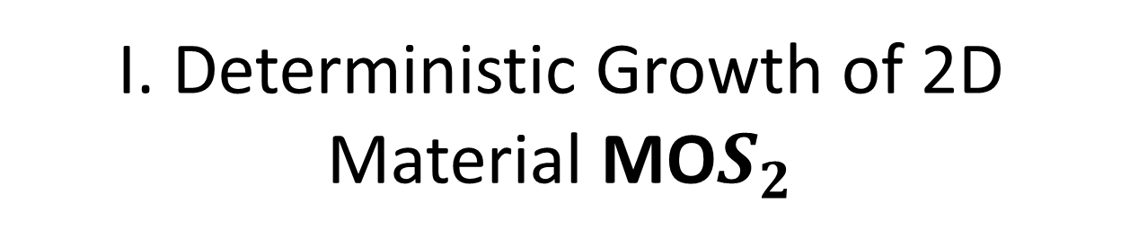
I. Deterministic Growth of 2D Material MO$S_{2}$

Slide 2
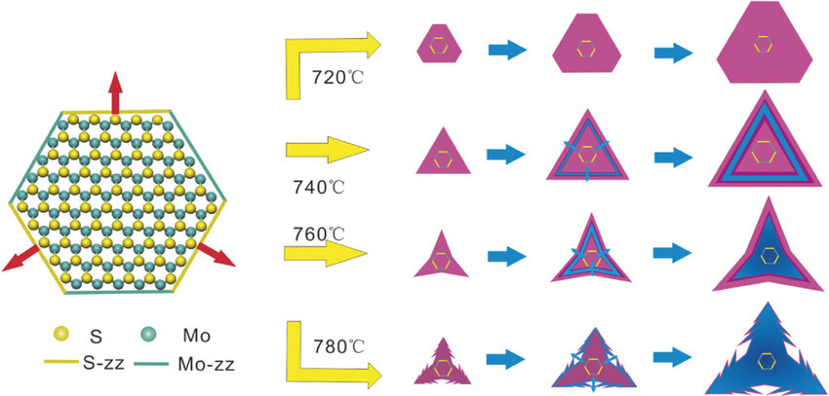
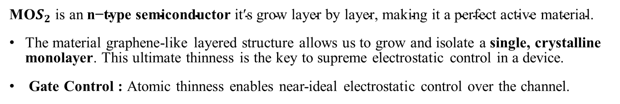

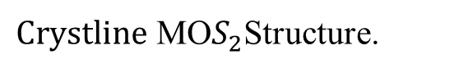
Deterministics growth of 2D Material MO$S_{2}$
MO$S_{2} \text{is} \text{an} \text{n}\text{−}\text{type} \text{semiconductor} \text{it}\text{′}\text{s} \text{grow} \text{layer} \text{by} \text{layer}\text{, }\text{making} \text{it} \text{a} \text{perfect} \text{active} \text{material}\text{.}$
The material graphene-like layered structure allows us to grow and isolate a single, crystalline monolayer. This ultimate thinness is the key to supreme electrostatic control in a device.
Gate Control : Atomic thinness enables near-ideal electrostatic control over the channel.
$Crystline \text{MO}S_{2}$Structure.
MoO₃ + S MoS₂ + SO₂
Crystallographic Growth. Different growth speeds Sulfur is Deficient property so low growth rate. The crystal naturally develops into a triangle, with the catalyst patch at its center.
ACS Publication

Slide 3
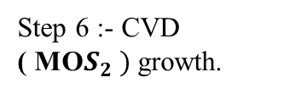
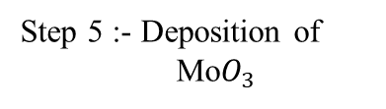
Process Flow -I
Step 1: Draw the Design using clewin software
Step 2: Take Si / SiO₂ substrate and clean it (Acetone → IPA → DI → N₂ dry)
Step 3:- Lithography
Step 6 :- CVD
( MO$S_{2} )$ growth.
Step 5 :- Deposition of
Mo$O_{3}$
Step 4 :- Verify using Microscopy

Slide 4
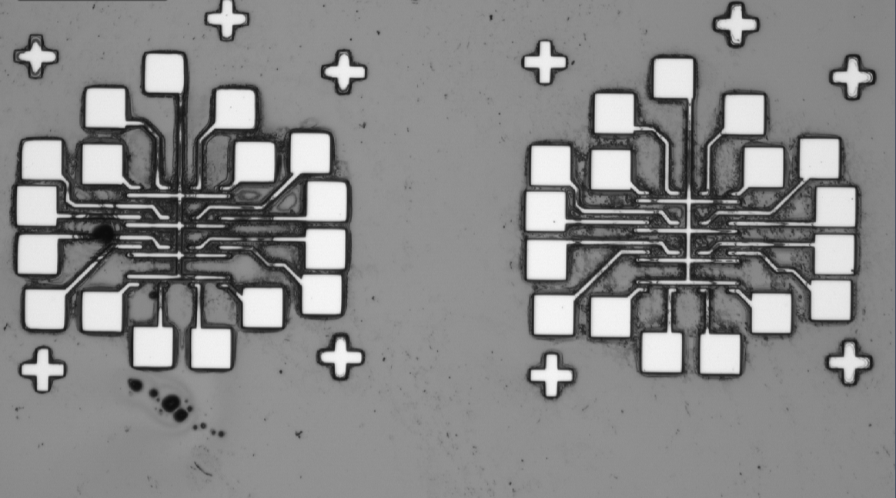
Process Flow-II
Step 7:- Optical Characterization (Raman Spectroscopy)
Step 8 :- : Take Substrate and clean it (Acetone → IPA → DI → N₂ dry)
Step 9:- Lithography
(Layer 2 “Contact”)
Step 6 :- Final Structure.
Step 5 :- Lift-off
Step 10 :- Verify using Microscopy

Slide 5
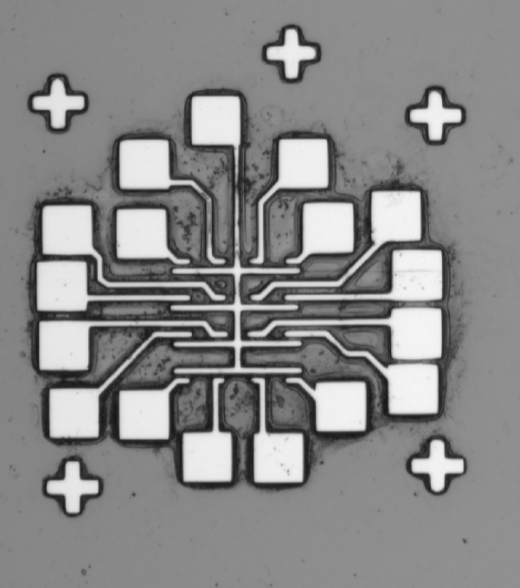
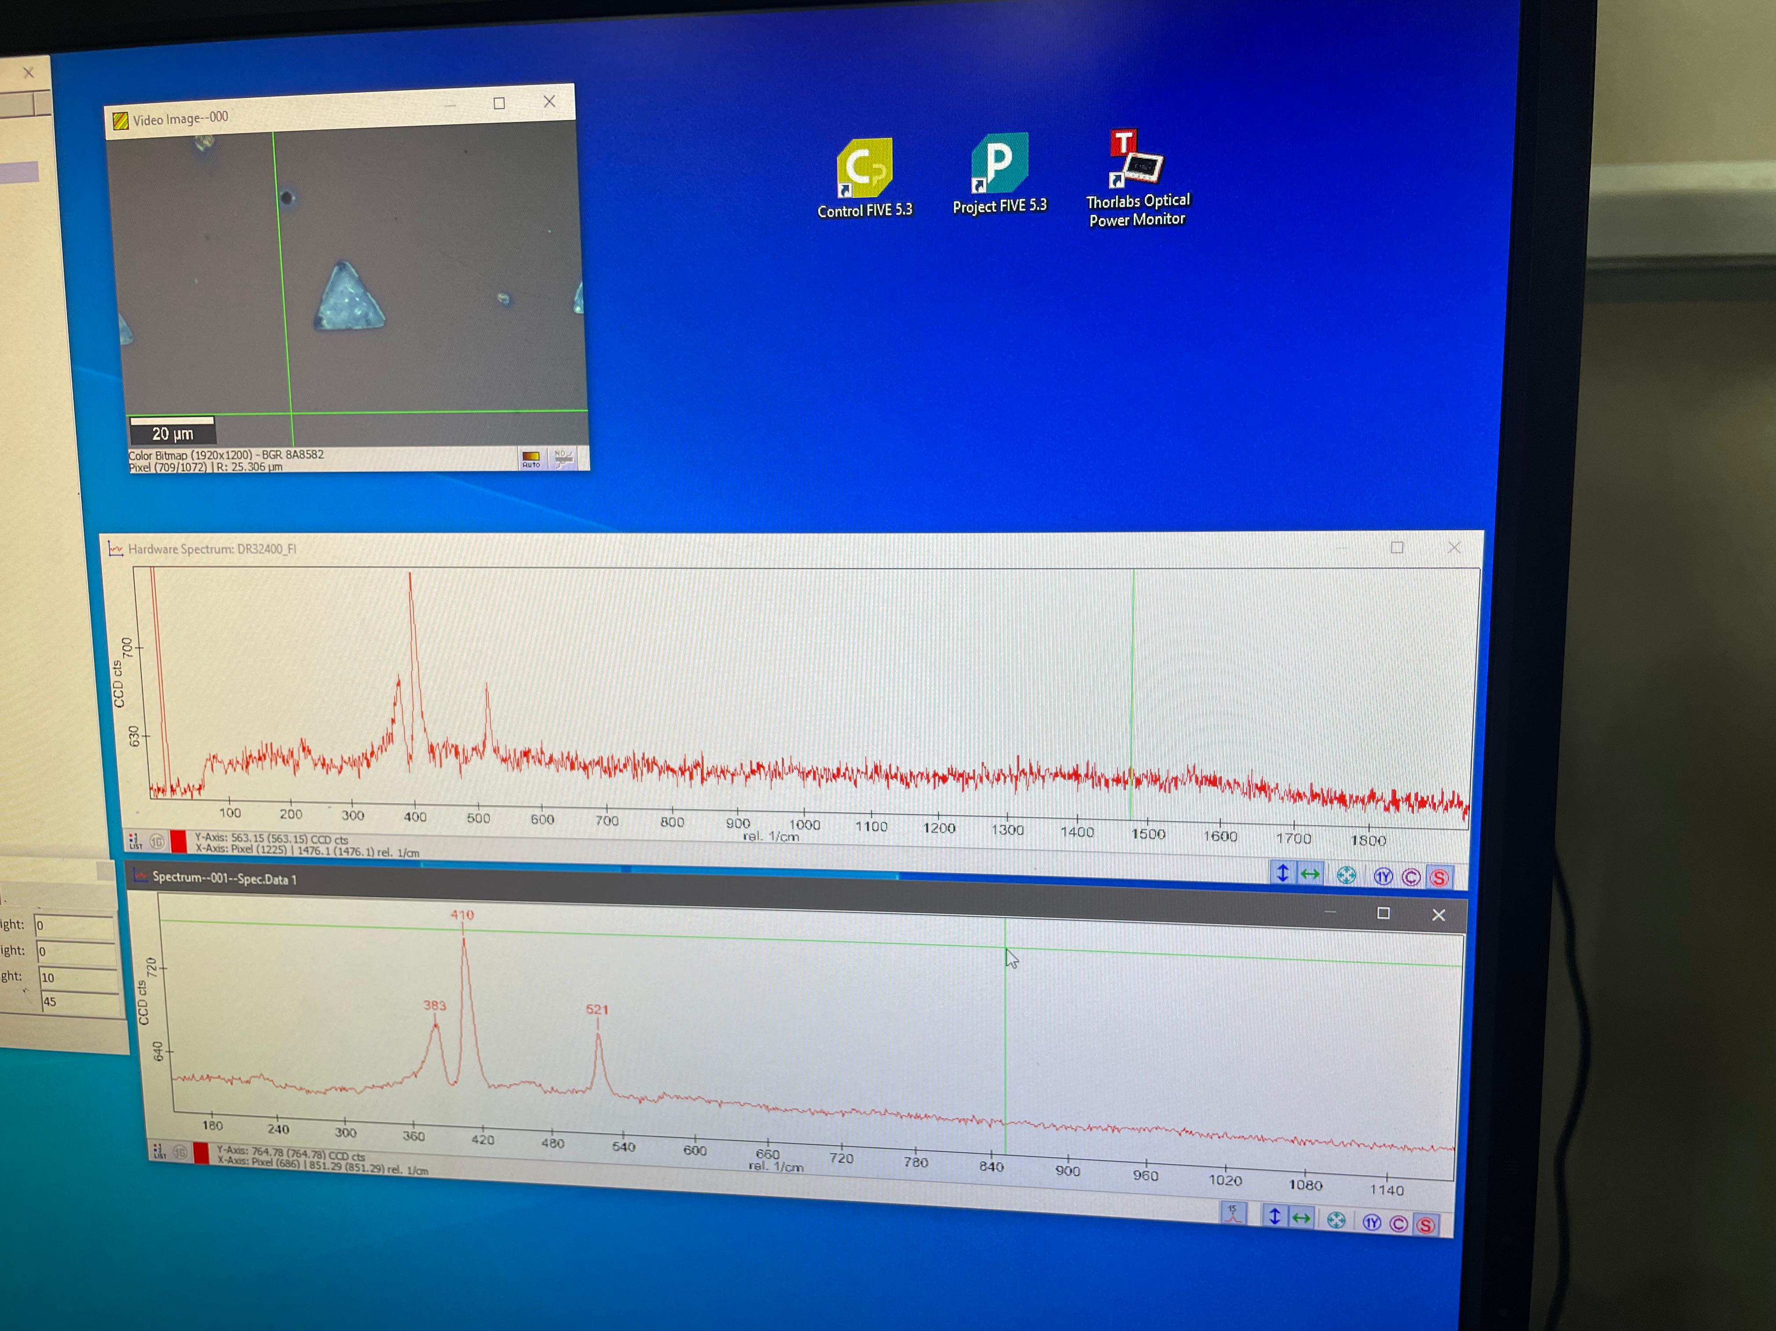
Learnings Inferred
1. Understanding of Deterministic Growth of MO$S_{2}$
1. Understanding of Deterministic Growth of MO𝑺_𝟐
2. Photolithography and Microfabrication Skills
3. CVD
4. Optical Characterization
Fig1. Pattern observed on microscope after lithography

Slide 6
INSTRUMENTS USED
Clewin software
Laser writer mediatek lw405b
Sputtering machine
Chemical Vapour Deposition
Raman Spectrometer
Keysight B1500A

Slide 7
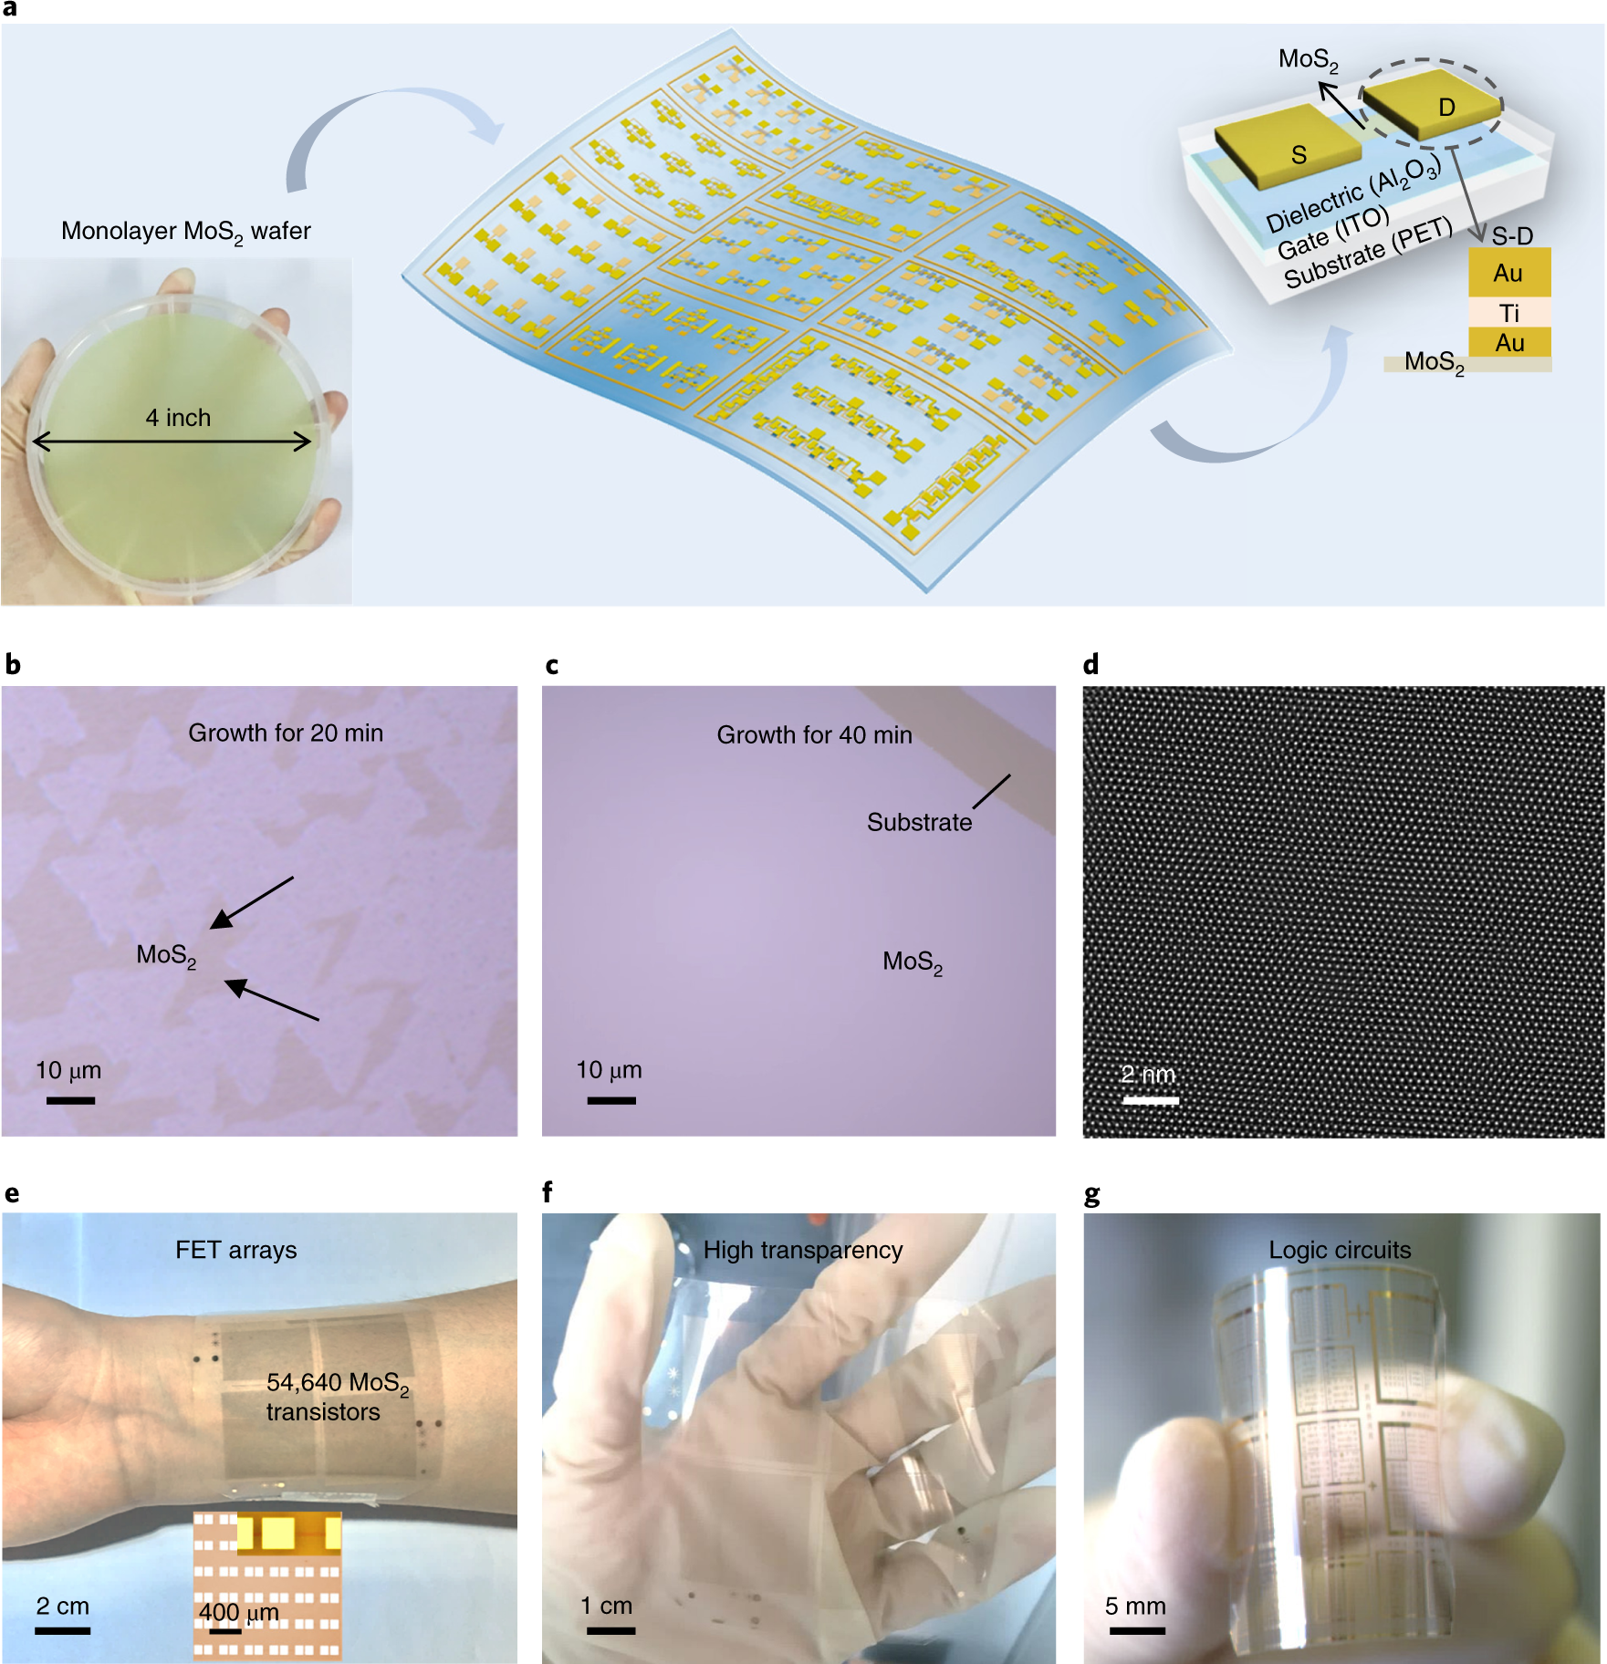
Applications
UTB (Ultra Thin Body Transistors)
Flexible and wearable electronics
nature.com

Slide 8
II. SnS₂ based Chemi resistive Gas Sensor Fabrication

Slide 9
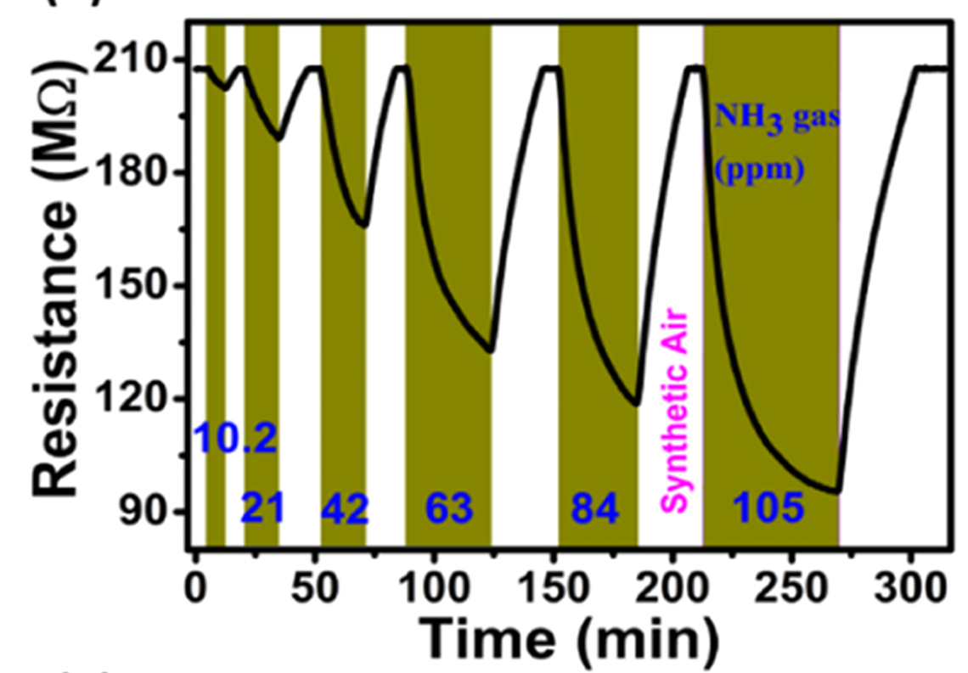
Working Principle
SnS₂ is an n-type semiconductor its behavior on adsorption with reducing and oxidizing gases gives us defining characteristics.
1. In AIR (Baseline Condition):
$O_{2}^{−}\left(ads\right)+e^{−}→2O^{−}$
Oxygen is adsorbed and capture electrons from the SnS₂ conduction band increasing resistance
1. In AIR (Baseline Condition):
O_2^− (ads)+e^−→2O^−
Oxygen is adsorbed and capture electrons from the SnS₂ conduction band increasing resistance
2. When NH₃ Gas Is Introduced:
$$NH_{3}+3O^{−}→N_{2}+3H_{2}O+3e^{−}$$
$NH_{3}$being reducing gas returns electrons back to the SnS₂ surface , decreasing resistance
2. When NH₃ Gas Is Introduced:
NH_3+3O^−→N_2+3H_2 O+3e^−
NH_3being reducing gas returns electrons back to the SnS₂ surface , decreasing resistance
3. After NH₃ is Removed (Recovery):
Oxygen adsorbs capturing electrons again , resistance returns back to baseline
Fig. Change in resistance with gas flow
SOURCE: Accelerating target analyte measurement in resistive sensors: A multiplier less first-order differentiation method with SnS 2 Naveen Kumar Bandari et.al

Slide 10
Process Flow-I
Step 1: Draw the Interdigitated Electrode structure in clewin
Step 2: Take glass substrate and clean it (Acetone → IPA → DI → N₂ dry)
Step 3: Spin coat S1813 on 3000 rpm to get (~1.5 µm) thickness
Step 6 : we do sputtering afterwards
Step 5 : Develop using (TMAH) developer solution for 30s
Step 4 : Direct Laser Writer (DLW) patterning with dosage 879 mJ/ cm²

Slide 11
Process Flow-II
Step 7: Prepare SnS₂ ink (20 mg in 0.5 mL ethanol)
Step 8: Drop-cast SnS₂ (~5 µL) at hotplate 70 °C
Step 9: Dry (60–80 °C)
Step 13 : Observing the graphs
Step 12 : Providing 5V across the electrode
Step 11: Electrical Characterization (probe station)

Slide 12

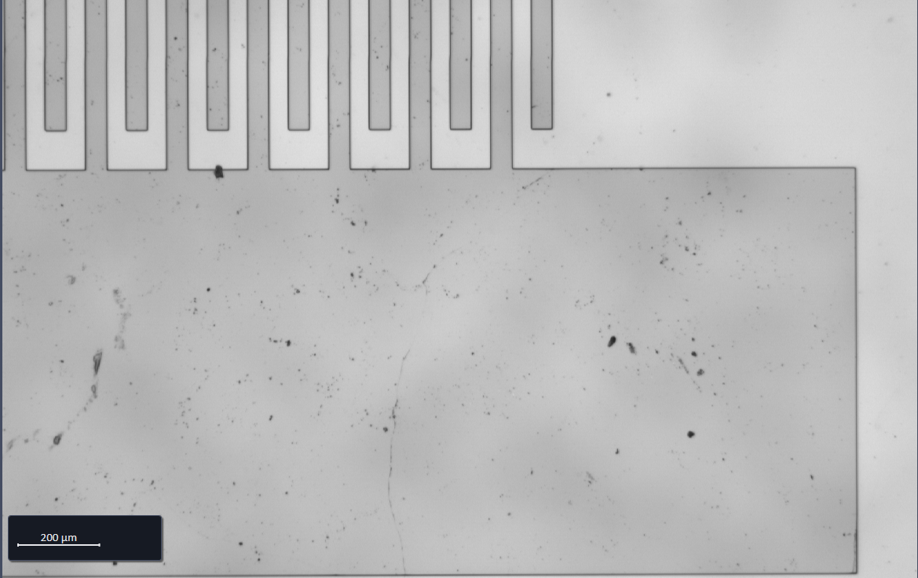
Learnings Inferred
1. Understanding of Gas–Semiconductor Interaction
2. Photolithography and Microfabrication Skills
3. Learning the Role of Electrode Geometry (IDEs)
4. Integration of Material with Microelectrodes
Fig. Pattern observed on microscope after lithography

Slide 13

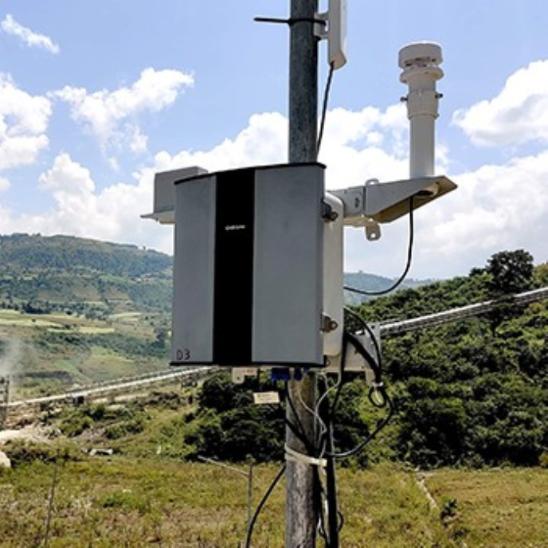
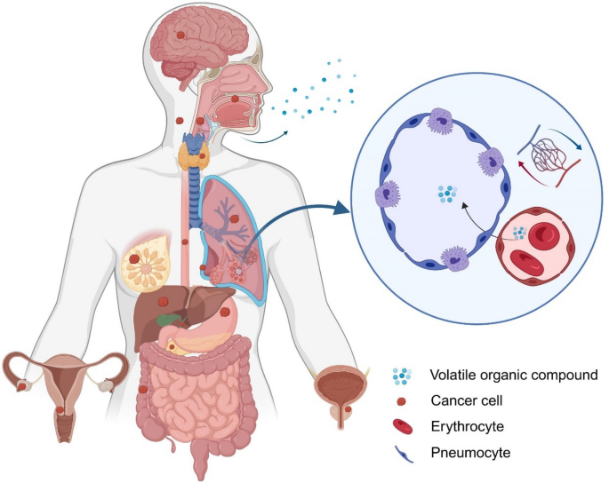
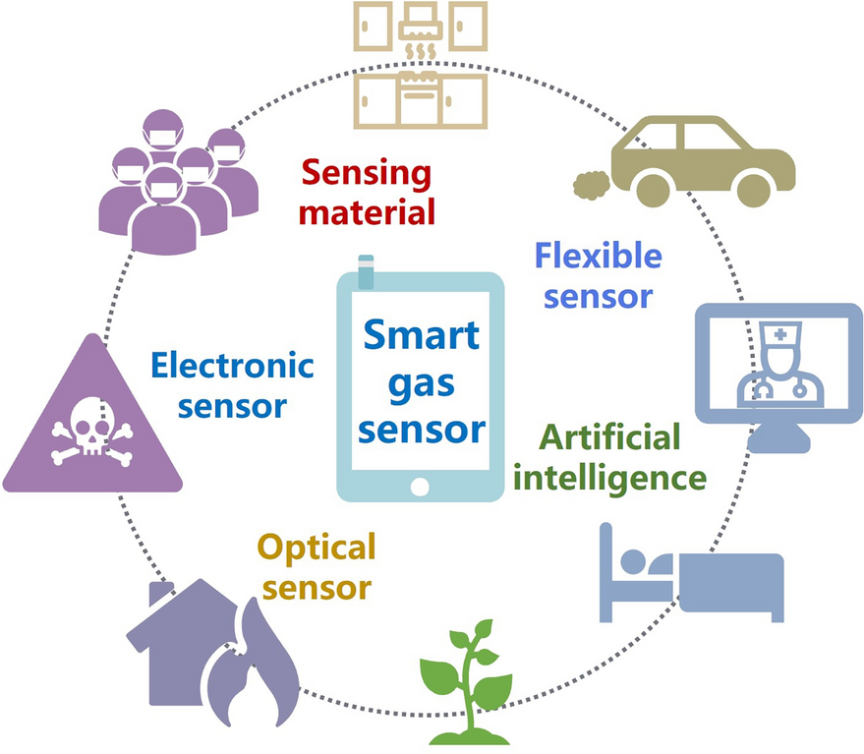
Applications
1. Industrial Safety and Hazard Detection
2.Environmental Pollution Monitoring
3.Healthcare and Biomedical Applications
4. Smart Sensors and IoT Integration
SOURCE: Google Images

Slide 14
1. Industrial Safety and Hazard Detection
Monitoring ammonia leaks in fertilizer plants, refrigeration units, and chemical industries.
2. Environmental Pollution Monitoring
Detection of NO₂, O₃, and SO₂, which are major pollutants in urban air.
3. Healthcare and Biomedical Applications
VOC detection for early disease diagnosis.
4. Smart Sensors and IoT Integration
SnS₂ sensors operate at room temperature, making them ideal for

